Slide 1
Consumer Shopping Behavior
Ximena Castillo
Vinita Singh
Casey Hojecki
Will Stephens
Notes:
Introduction of group members

Slide 2
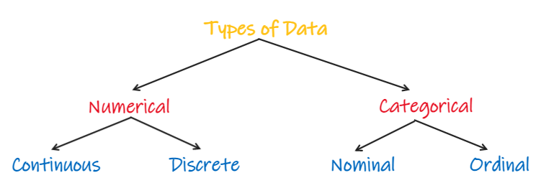
About the Dataset
Synthesized by ChatGPT
Simulates real-world consumer behavior
Categorical/Nominal Data such as Season and Gender
Numerical/Continuous Data such as Age
Notes:
Explain our data source, what research we will be doing and why we found it interesting:
“After doing some of our own ‘shopping’ on Kaggle, we were able to find a dataset that contained information containing customer’s shopping details. Kaggle disclaimed that this dataset was Synthesized by ChatGPT, however it was created in a way that mirrored or simulated real-world consumer behavior patterns. The data inside this dataset was very mainly categorical like Season and Gender, but we were also able to focus in on numerical data such as age

Slide 3
Research Questions
Seasonal Data
Is there variation in purchasing patterns with seasons?
Gender
How do purchases breakdown by gender through summary statistics?
Age Groups
What are the most popular categories among different age groups?

Slide 4
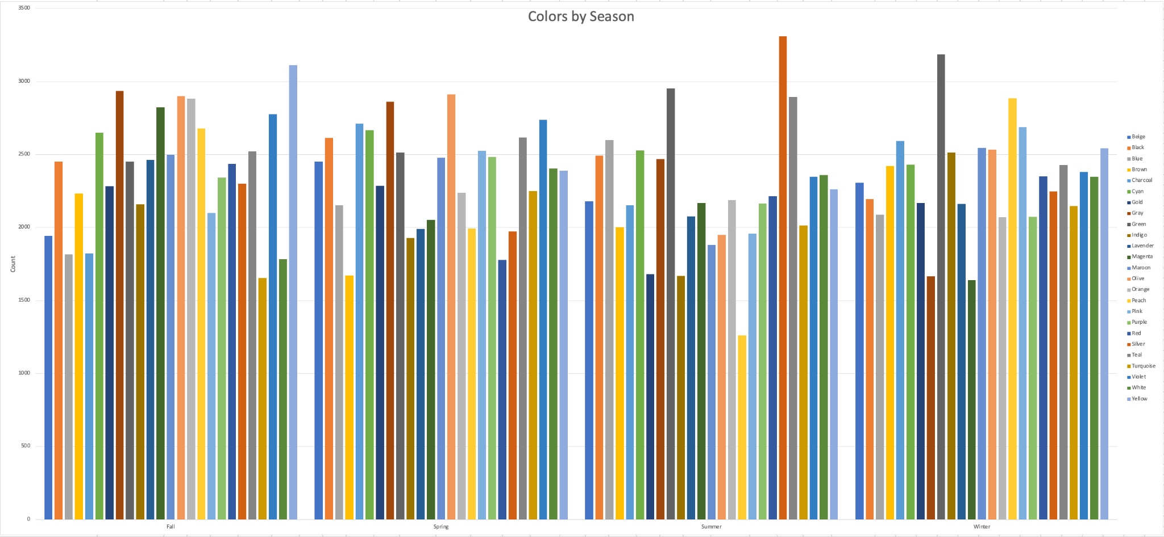
Products Purchased by Color Seasonally
Notes:
First, relationships were assessed using pivot tables in excel and parameters for further analysis were established. I selected item type purchased and color of item purchased as the two variables of most interest for further inquiry from the data set. However, as you can see by how busy these graphs are, they needed to be cleaned up.

Slide 5
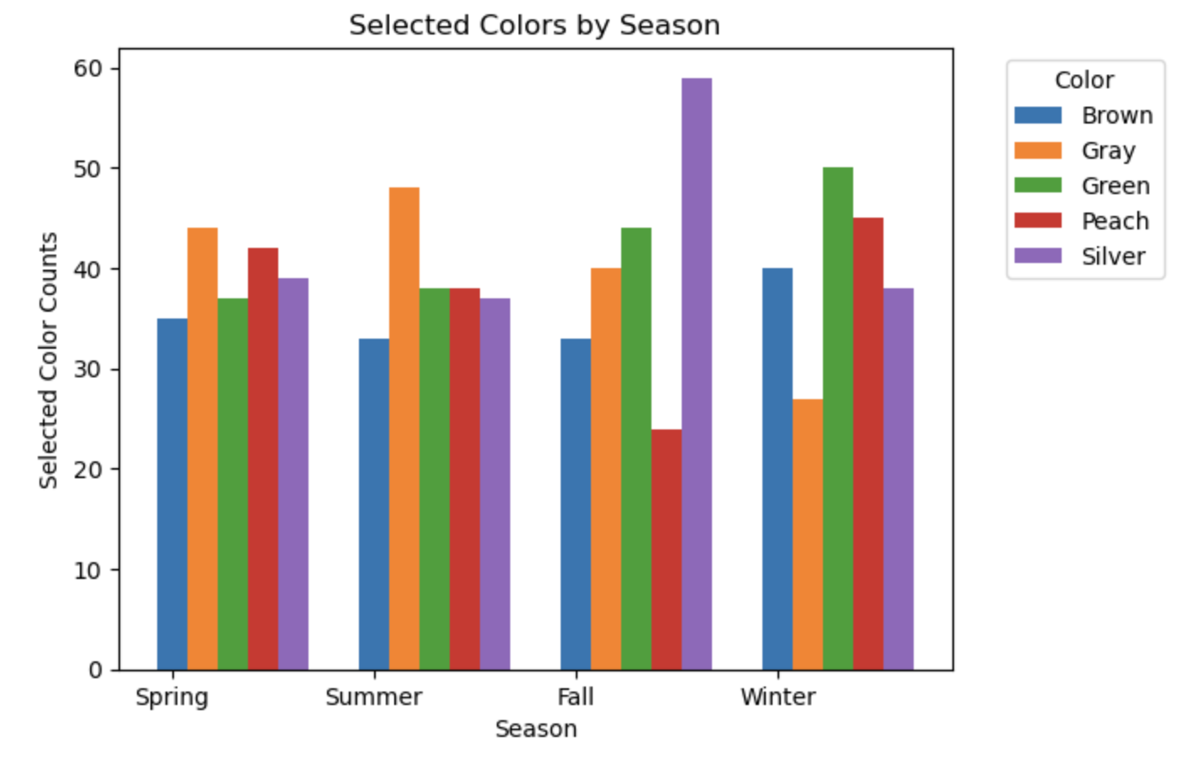
Products Purchased by Color Seasonally - Subset
Notes:
The data was paired down to 5 colors of interest. These were chosen based on colors representing the max, min, and highest range of values among the set. Brown is an example of a color that remained relatively constant throughout the year, while the others selected saw more movement. For example, purchases of silver items peaks significantly in the Fall, perhaps corresponding the winter holiday attire. These values are number of instances, which does reflect trends if analyzed by sum of purchases, but I thought this was more representative of the relationships between these variables.

Slide 6
Chi-Squared Test of Independence
Designed for Categorical Data like “Season” and “Color”
Results:
Degrees of Freedom: 12, alpha=0.05
Critical Value: 21.026
Chi Squared Statistic = 0.473
Drawn Conclusions:
Chi Squared value of 0.473 is less than critical value 21.026
Fail to reject null hypothesis
Suggests there is not enough evidence to conclude a significant association between color and season based on the corrected data

Slide 7
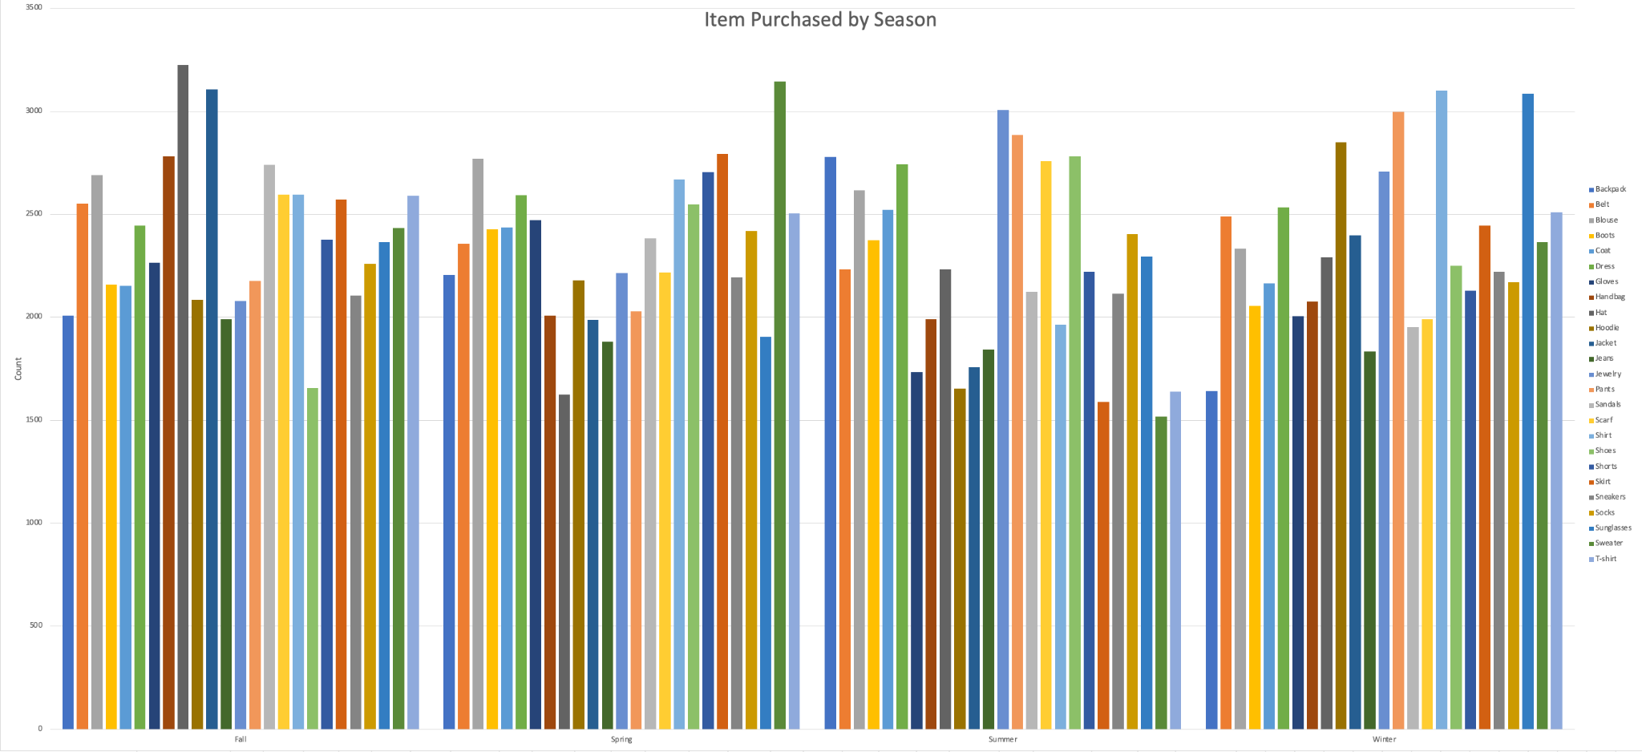
Products Purchased by Product Type - Seasonally

Slide 8
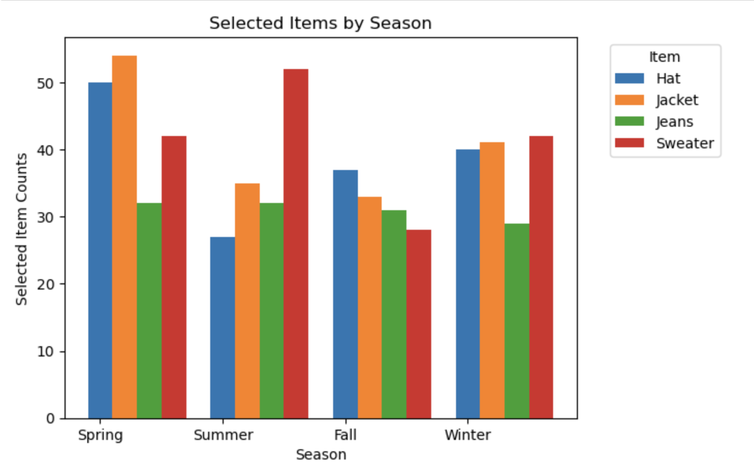
Products Purchased by Product Type - Subset
Notes:
A similar process was used to produce this graph. These items best represented the full set of purchased items. Purchases of jeans remained constant throughout the year, and also represents the middle of the pack among all items. You can see a similar trend in that both hats and sweaters see a peak of purchases in the warmer time of the year (spring and summer respectively). This would seem counterintuitive at first, but malls typically offer clearance sales after peak season for items which could explain this trend.

Slide 9
Chi-Squared Test of Independence
Designed for Categorical Data like “Season” and “Item Purchased”
Results:
Degrees of Freedom: 12, alpha=0.05
Critical Value: 16.916
Chi-Square Statistic: 24.42
Drawn Conclusions:
24.42 > 16.916
Can reject null hypothesis
Suggests there is enough evidence to conclude a significant association between item purchased and season based on the corrected data

Slide 10
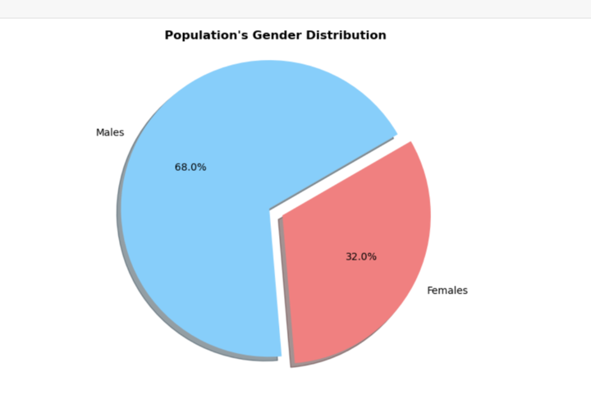
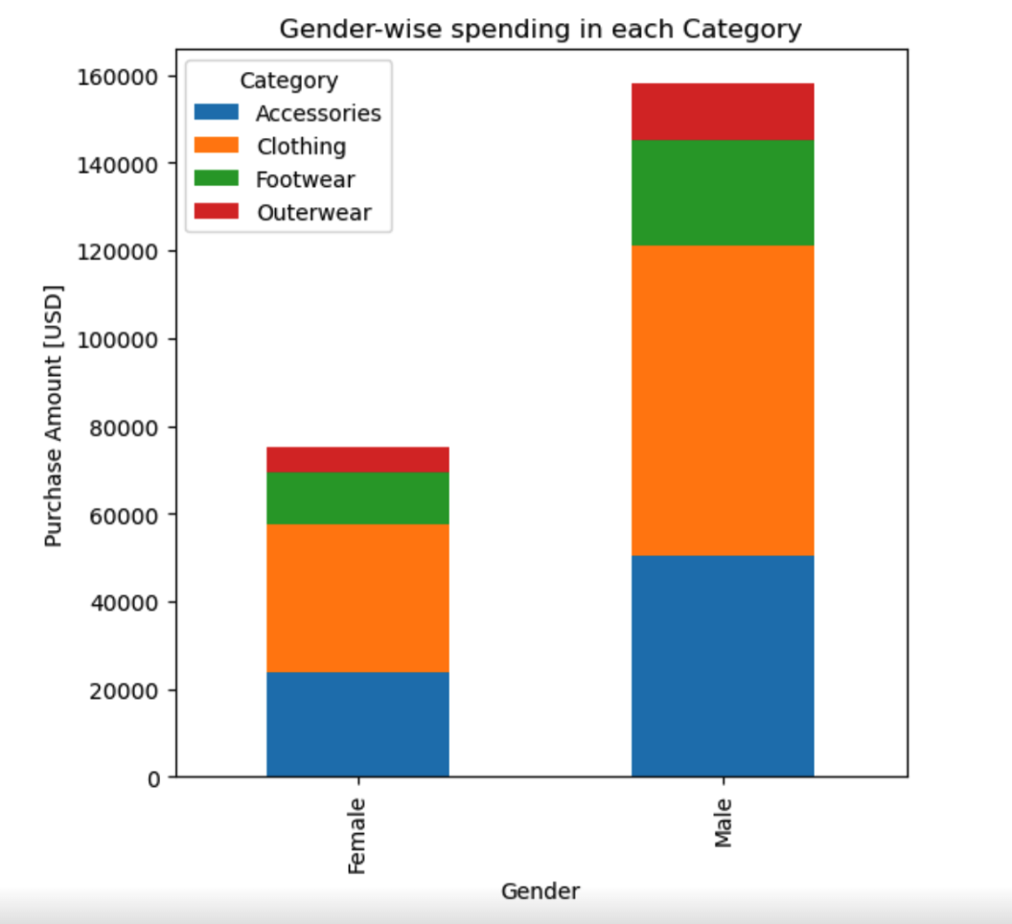
Shopping Trends by Gender

Slide 11
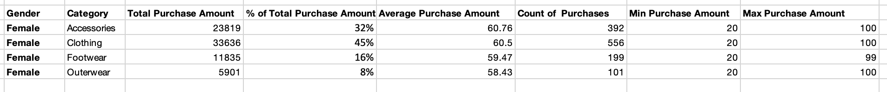
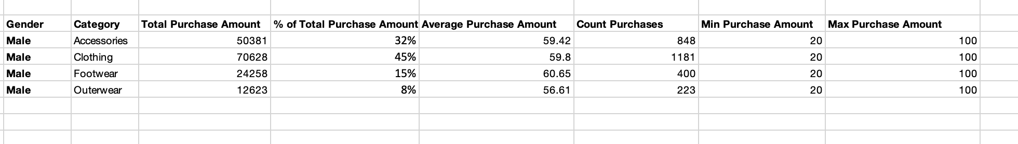
Aggregation Statistics
Female:
Male:

Slide 12
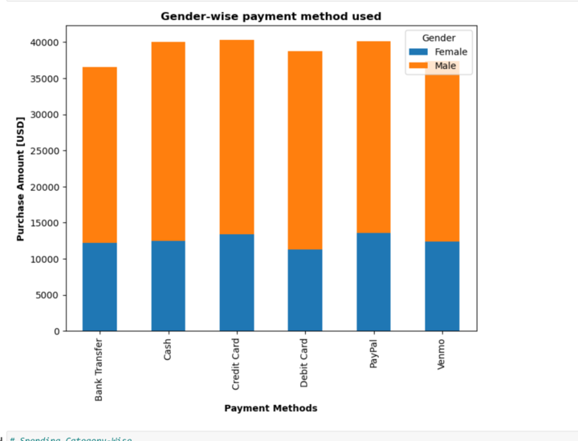
Payment Method by Gender

Slide 13
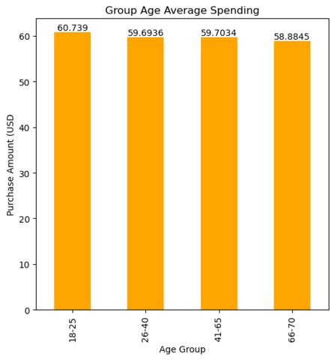
Shopping Trends by Age Groups
CONTEXT:
Spending habits across 4 different age groups to analyze spending behaviors in a structured manner.
18 – 25
26 – 40
41 – 55
56 – 70
CONCLUSION:
The youngest age group has the highest bar indicating average of $60.74.
The oldest age group has the lowest bar, indicating a minimal drop to an average spending of $58.88.
Conclusion: Marketing strategies should go beyond the age group when targeting consumers as spending power since older people remain very competitive.

Slide 14
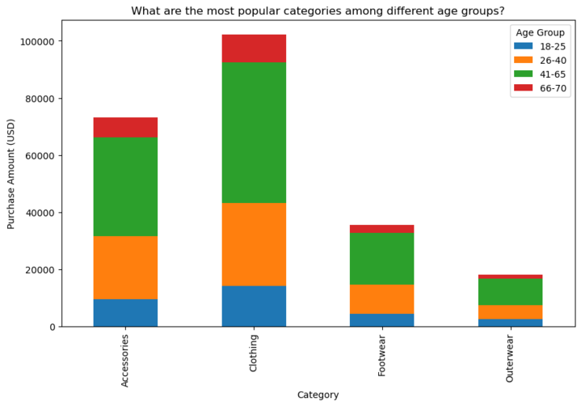
Product Category Popularity by Age Groups
Conclusions:
Clothing is the most popular category across all age groups.
The 18-25 age group shows a strong preference for clothing, making the most significant contribution to purchases in this category.
Accessories are the second most popular category, with the 41 - 65 age group leading the purchases, indicating interest in accessories among this demographic.
The 66-70 age group spends the least across all categories.
The 18 - 25 and 26 - 40 age groups show more similar spending patterns.
There is a significant drop in purchase amounts in the outerwear category for all age groups when compared to other categories.

Slide 15
Q&A

